Slide 1


Advanced Battery Management System
Electronics Club

Slide 2
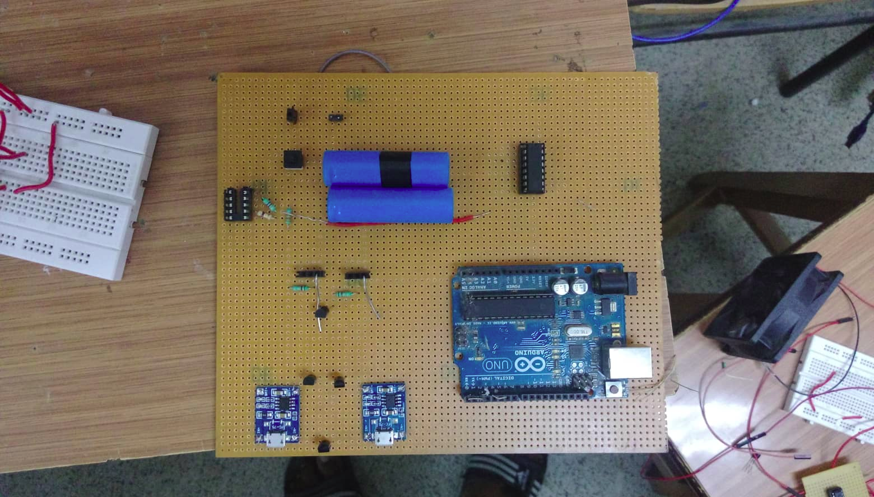

Slide 3
What is ABMS!!
Battery Management Systems are the brains behind battery packs. They manage the output, charging and discharging and provide notifications on the status of the battery pack. They also provide critical safeguards to protect the batteries from damage.
The most important function that a battery management system performs is cell protection. It is also avoids waste of energy.

Slide 4
Why is ABMS required!!
Overcharging or over discharging of cells.
Increases the battery life
Increase the efficiency of the battery
To prevent the damage of the circuit.
Notes:
Overcharging of Lithium ion cells can damage them and cause overheating and even explosion or flame so it's important to have a battery management system to provide overvoltage protection.
Lithium ion cells can also be damaged if they're discharged below a certain threshold, approximately 5 percent of total capacity. If the cells are discharged below this threshold their capacity can become permanently reduced.

Slide 5
How did we solve it
Our battery management system resolves the issues by using:
A battery protection circuit
Use of Active cell balancing for minimal energy waste
Estimating SOC to monitor over the state of battery

Slide 6
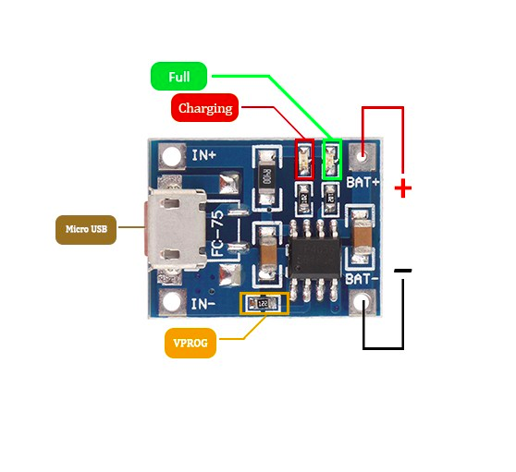
Safe Charging and Discharging
TP4056 are the prime source in order to solve this problem.It also prevents short-circuiting.
Notes:
It is important to have a safe passage of current to lithium cells as it is inflammable and likely to explode due to overheating and over passage of current. And in order to expand the life cycle of the cells it is important to charge the cell by constant current and then by supplying constant voltage source. While Discharging care should be taken that the current is less than the actual rating of the cell.

Slide 7
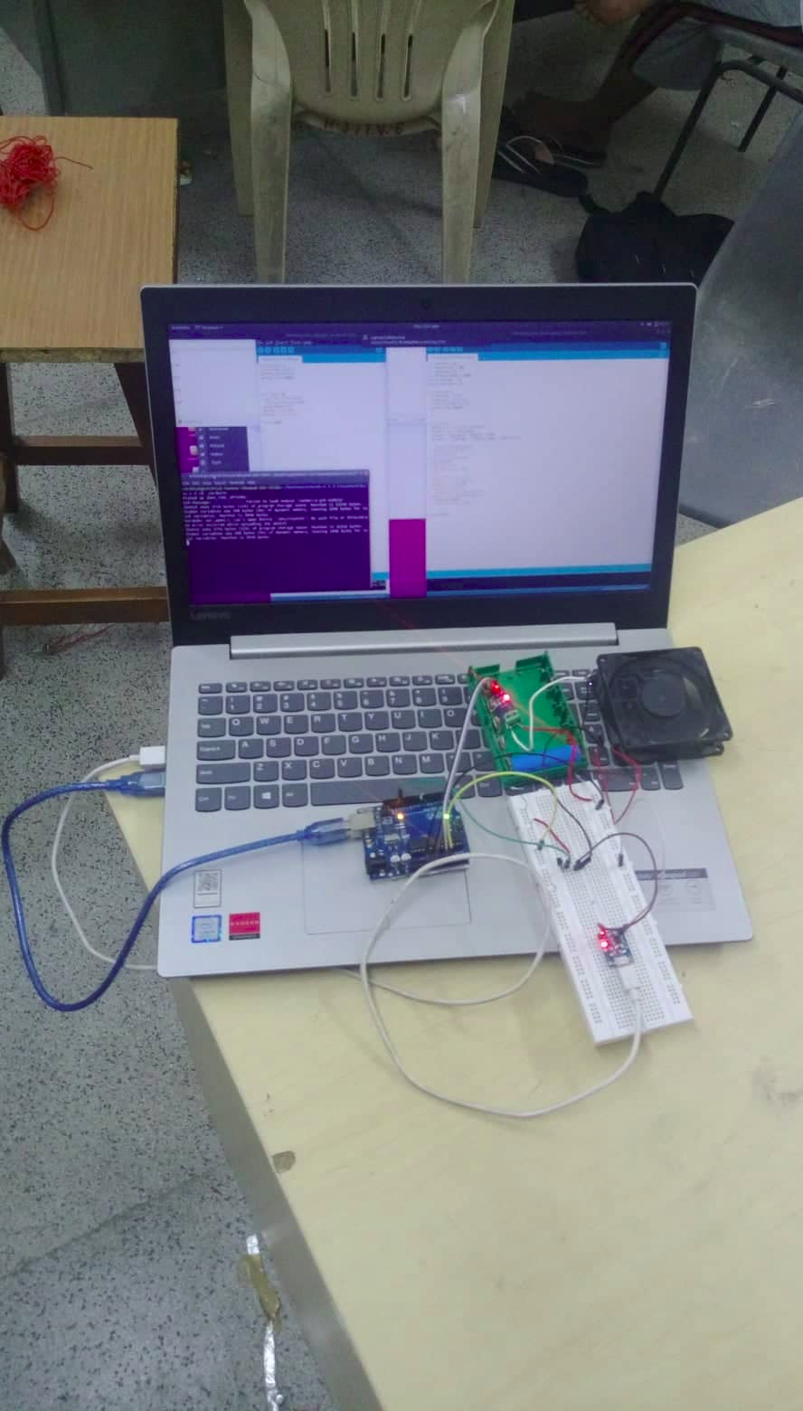
Safe charging and discharging is done with TP4056 and current sensors

Slide 8
State of charge calculation
Basic Definition of SOC = (Present Capacity / Max. Capacity) *100
Following are few ways to calculate SOC :
Coulomb counting method
Kalman Filter
Notes:
It defines the battery percentage that the stacks of cell has, like the one present in the right most corner of the mobile (the indication).

Slide 9
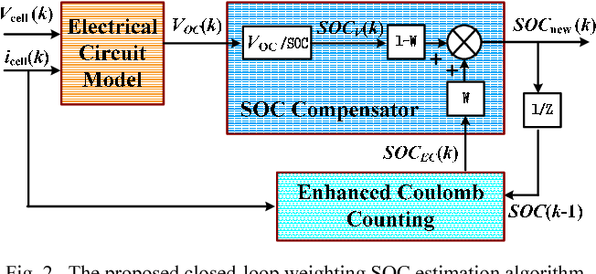
State of charge calculation
Coulomb Counting Method :
Advantage : This method is effective and one of the simple methods to find the SoC.
Disadvantage: The SoC must be re-calibrated on a regular basis, such as by resetting the SoC to 100% when a charger determines that the battery is fully charged.
Notes:
Laptops, medical equipment and other professional portable devices use coulomb counting to estimate SoC by measuring the in-and-out-flowing current. Ampere-second (As) is used for both charge and discharge.

Slide 10
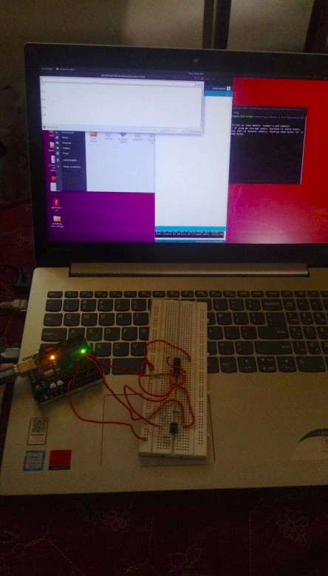
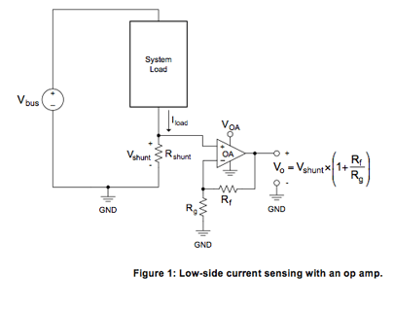
Current Sensor

Slide 11
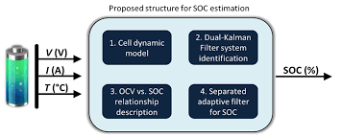
Kalman Filter
Kalman filters are ideal for systems which are continuously changing.
Advantage:
light on memory (they don’t need to keep any history other than the previous state)
very fast (making them well suited for real time problems and embedded systems.)
Notes:
We can use a Kalman filter in any place where you have uncertain information about some dynamic system, and you can make an educated guess about what the system is going to do next.
light on memory (they don’t need to keep any history other than the previous state)
very fast (making them well suited for real time problems and embedded system

Slide 12
Kalman Filter
Used Kalman filter to reduce noise in current sensor
Notes:
We are using kalman filter to find out the SOC of our battery System.As we know that SOCis dynamical in nature, so we use our mathematical /System Model to forecast the value Of SOC along with the covariance Associate with it. Now this predicted value is being compared mathematically with the measured value So we get a more accurate value with minimum error as assumed by the algorithm .Now the system Update the SOCºs values and other parameters and the process proceeds Continuously.

Slide 13
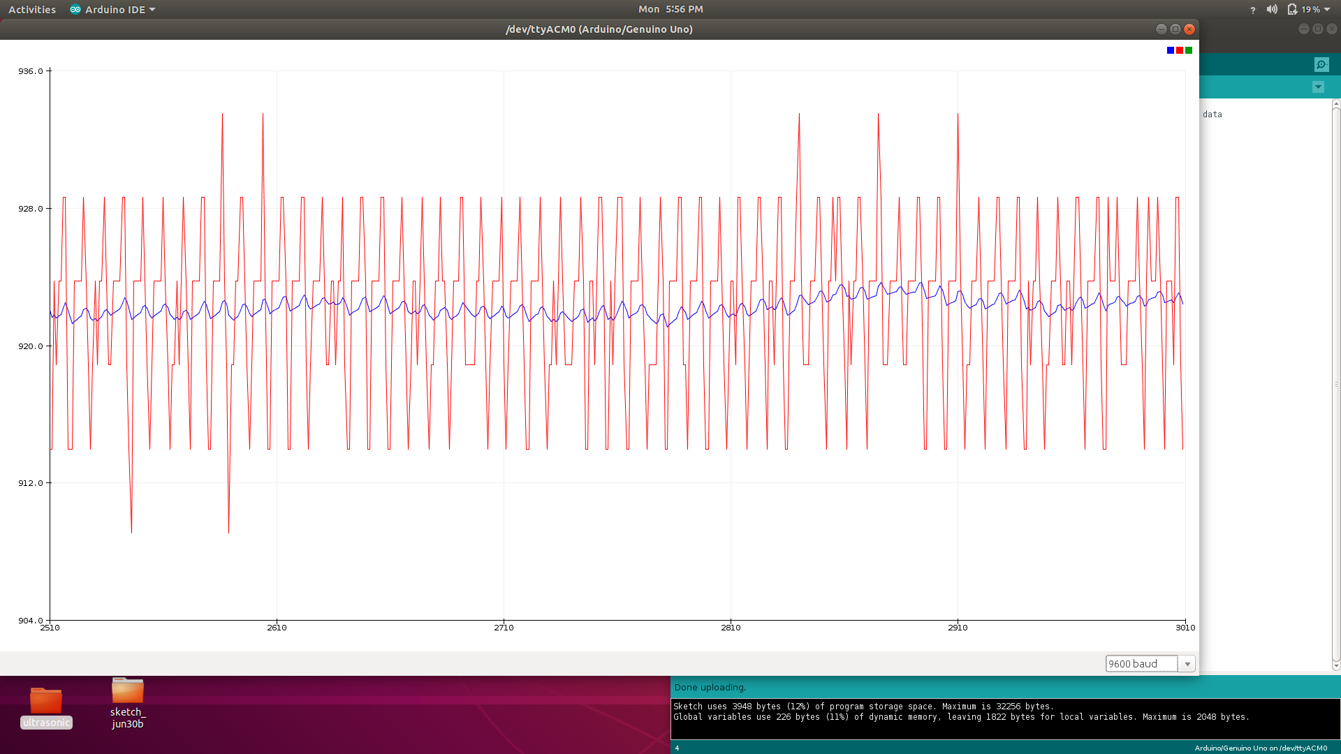

Slide 14
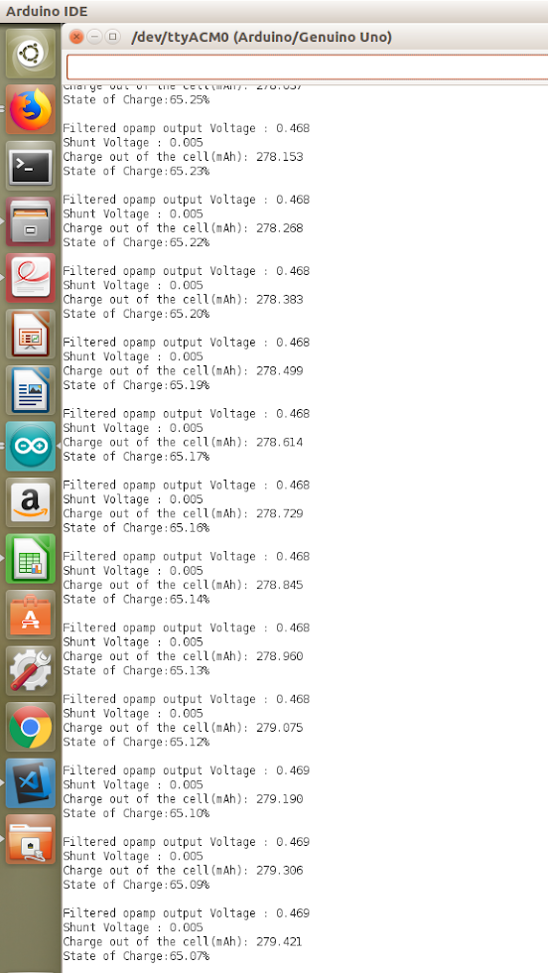
SOC calculation along with filtered output voltage

Slide 15
Active cell balancing
Cell balancing is required because Li ion cells are not identical
distributes the charge among the cells based on SOC calculations.
better than passive cell balancing
Notes:
even being of same manufacturer/ type, hence, cannot be charged/ discharged for the same time, if done so , will cause serious damage to cells.
as this balancing technique dissipate excess charge as heat from the individual cells that are determined to have a higher voltage than others in the pack, resulting in waste of energy.

Slide 16
Implementation of Active Cell Balancing
Our Algorithm for active cell balancing is just charging the slightly discharged battery via TP4056.
Here multiplexers are used to find the voltage across cells.
Less charged cell are been charged with the input from the battery itself.
From the graph of Tp4056 module getting the time taken to charge it.
Doing it continuously but only when it is discharging.
Notes:
Primitively , It is done with just two cells which are connected in series
The voltage across the cells is managed by Arduino as the voltage across the cell is always less than 5v. Potentiometer is used to adjust the output voltage which the slightly discharged cell requires.We need to follow the basic charging principle during this act. Two cells can further extended to five cells via healthy multiplexer using the same algorithm recursively.

Slide 17
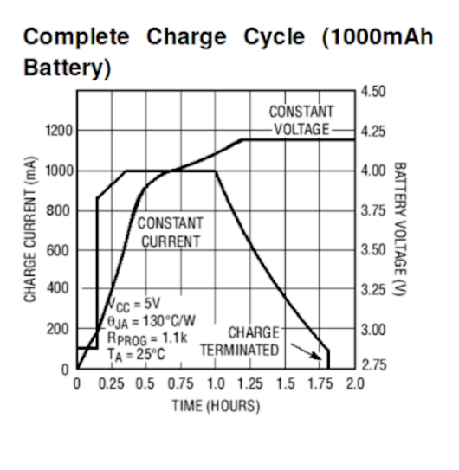

Slide 18
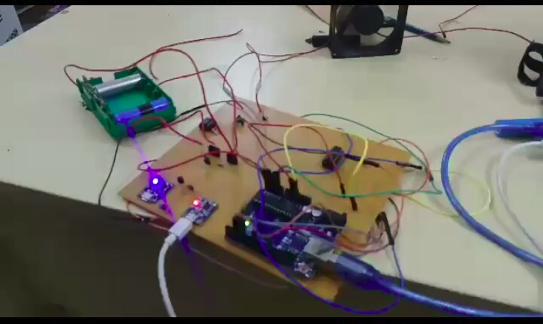
Balancing two cells

Slide 19
Over charging/discharging Protection 1. TP4056 2. 5A 3s charging protection module
Active cell balancing 1. TP4056 2. Multiplexer(CD4052)
SOC calculation 1. Current sensor

Slide 20
TP4056: It is the charger IC for the 3.7V li-ion Battery. It Automatically and efficiently tells us the completion of charging. It actually charges with the basic principle of charging via constant current and constant voltage.
Multiplexer: It is a combinational logic circuit designed to switch one of several input lines through to a single common output line by the application of a control signal. Multiplexers operate like very fast acting multiple position rotary switches connecting or controlling multiple input lines called “channels” one at a time to the output.
Op-Amp : An operational amplifier (often op-amp or opamp) is a DC-coupled high-gain electronic voltage amplifier with a differential input and, usually, a single-ended output.
Current Sensor : It measures current across the load with the help of Hall-Effect which effectively develops a linear proportionality b/w current and voltage.

Slide 21


Slide 22
Workflow
Worked on the basic understanding of project
Worked on deep understanding of project.
GLCD display control, working of boost convertors and various sensors
SOC calculation methods,
Safe charging and discharging, TC4056 working
Implementation of Kalman filter and Active cell balancing(using buckboosters)
Gathering all in a circuit and then making it in GPB board.

Slide 23
Conclusion
What have we done: 1.Completion of safe Charging and discharging.
2. Implementation of Active cell balancing between two cells (not enhanced)
3. Op-Amp circuits are used to sense current.
4. Displaying the required elements for the users.
5. To implement TP4056 to all cells.

Slide 24
Team Members
Mentor : Nithish Bhumireddy
Members : 1.Maitreyee Srivastava
2.Neha Chauhan
3.Nitesh Barupal
4.Sachin Gupta
5.Reithick Anbarasu

